Slide 2
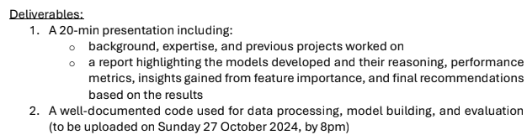
Assignment + Deliverables
Exploratory Data Analysis
Feature Engineering
Build Model
Hyperparameter Tuning
Model Evaluation
Explainability

Slide 3
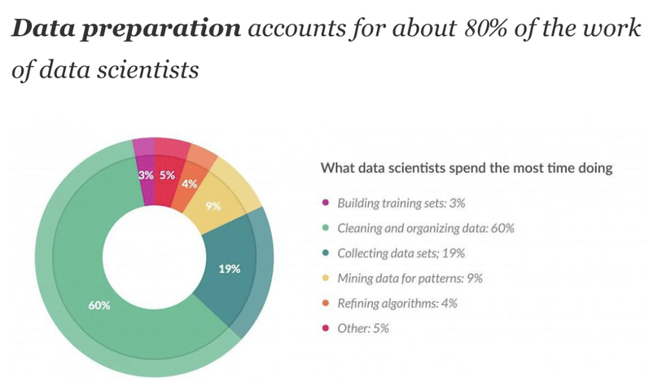
Time allocation – 80/20 rule
Effort spend:
~2 days
Not all steps done (to the needed extend)
Aim:
Give idea on how I approach
Questions that came up along the way
"Playing the whole game": A data collection and analysis exercise with Google Calendar - Scientific Figure on ResearchGate. Available from: https://www.researchgate.net/figure/The-80-20-rule-of-data-wrangling_fig2_339550606 [accessed 25 Oct 2024]

Slide 4
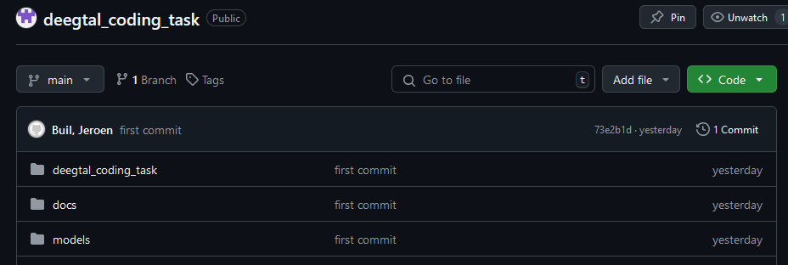
Git Repository
https://github.com/JeroenBuil/deegtal_coding_task
For this project
Stack:
Python
VSC
In reserve
Stack:
MS Azure
Databricks
SQL
Power BI
…
Packages:
MNE
SKLearn
Matplotlib
DIY

Slide 5
Exploratory Data Analysis
What are we dealing with?
Data quality?
Preprocessing?
Patterns?e
Quick Stats:
2 Groups
Unknown conditions
Unknown stimuli
5 recordings each
Recording time: ~20-25min
Fs: 250 Hz
Filtering: 125 Hz lowpass

Slide 6
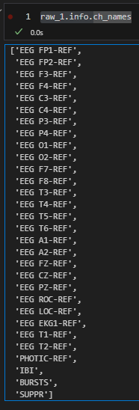
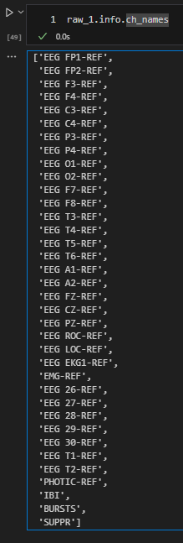
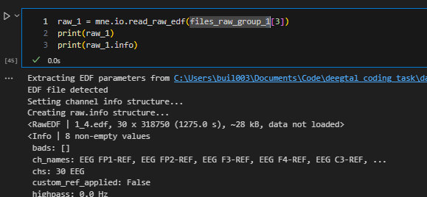
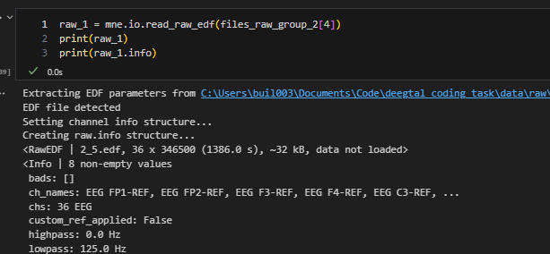
Data Quality - Consistency
Different recording methods (30ch vs 36ch)
Different experimental procedure (photic stim vs ?)

Slide 7
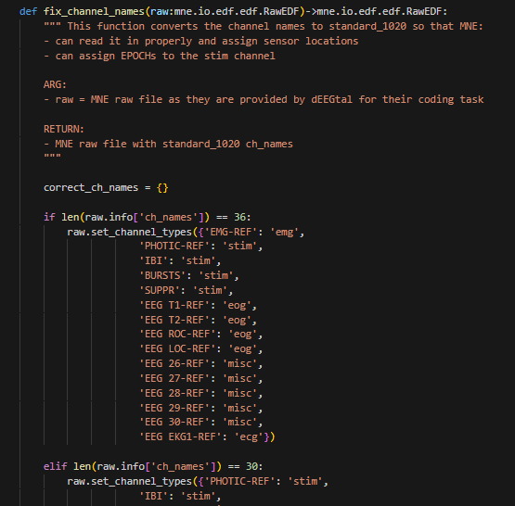
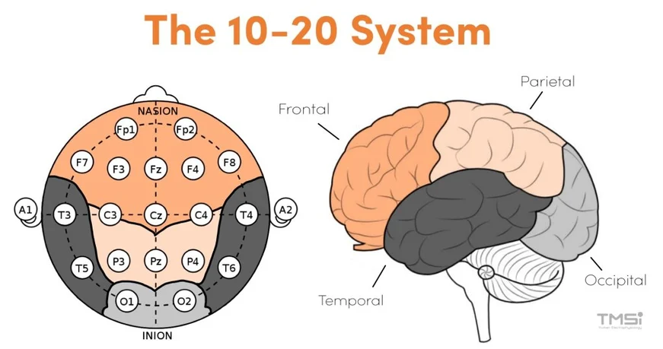
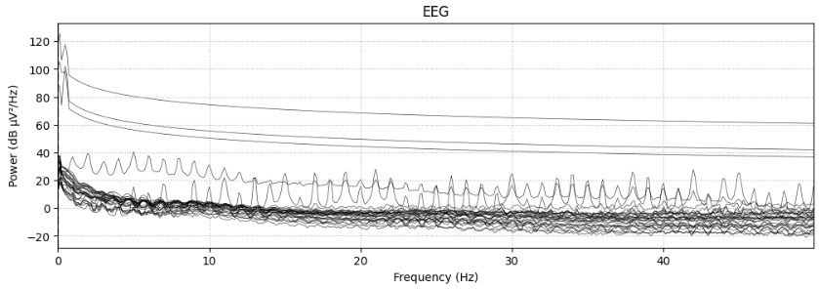
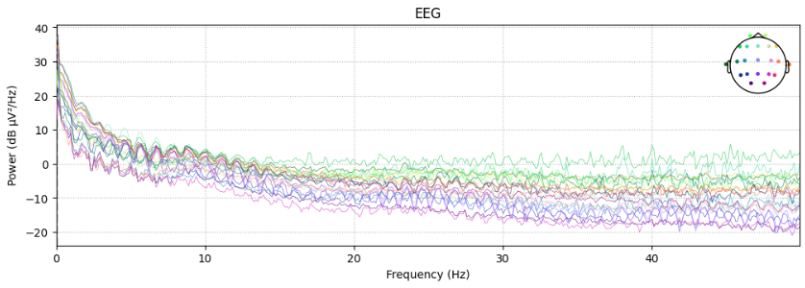
Data Quality – Ch names
Channels not in 10-20 montage naming
=> Fix + set_montage()
=> Simplifies working with MNE
https://info.tmsi.com/blog/the-10-20-system-for-eeg

Slide 8
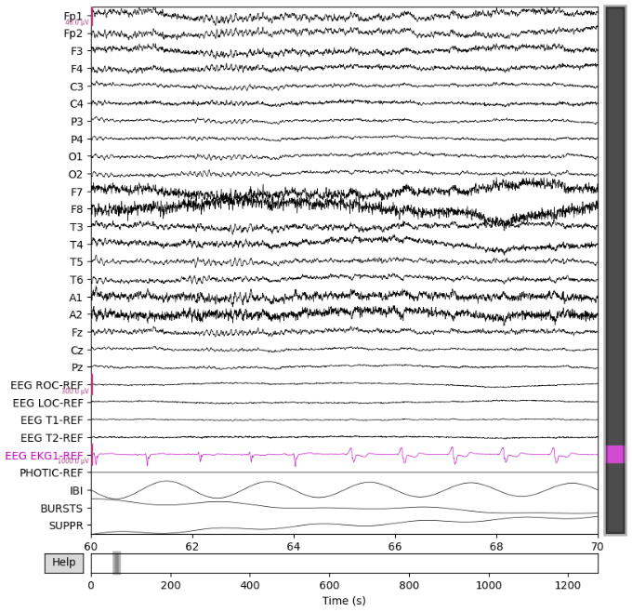
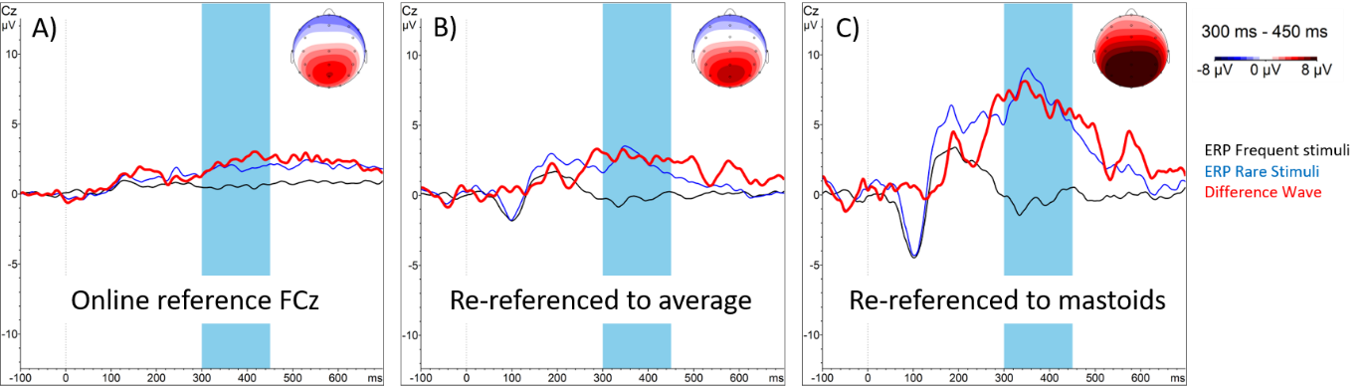
Referenced?
https://pressrelease.brainproducts.com/referencing/

Slide 9
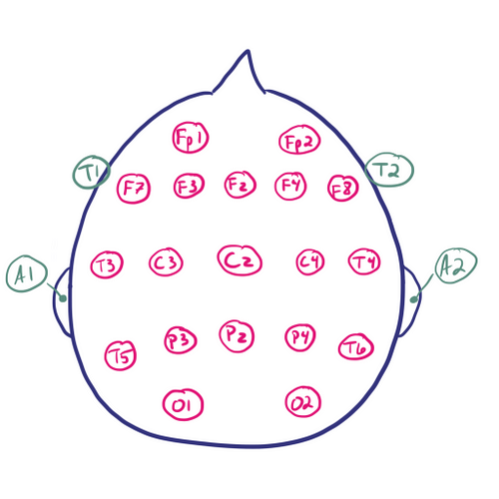
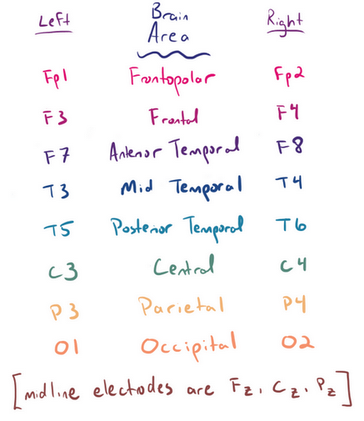
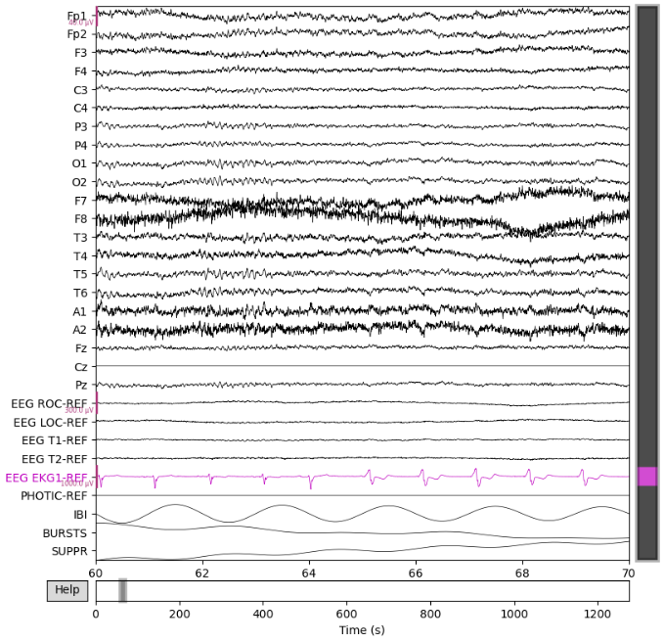
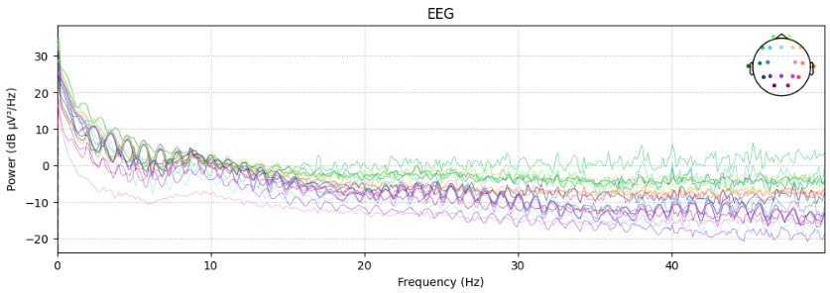
Re-referencing?
https://www.learningeeg.com/montages-and-technical-components

Slide 10
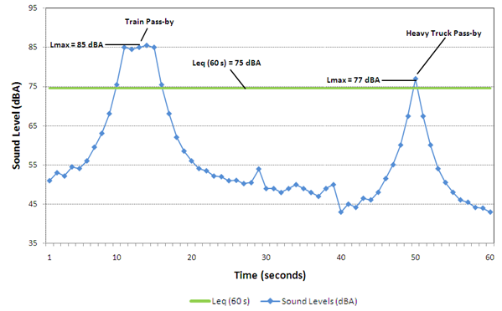
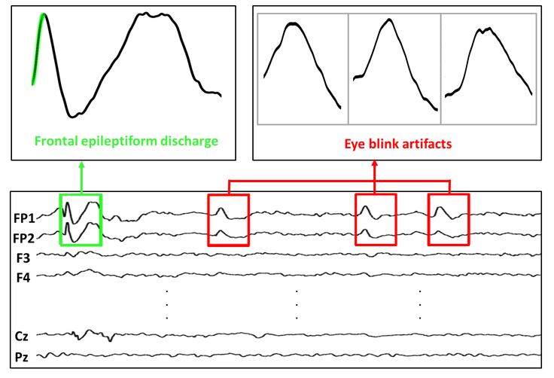
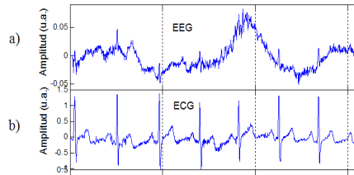
Artifacts in EEG Signals and Preprocessing
Non-biological/Environment
Biological
Powerline noise, traffic
=> bandpass + bandstop filtering
eye blinking, movement, respiration, and heartbeat
Often same freq range => grounding, linear regression methods
A Survey on Artifacts Detection Techniques for Electro-Encephalography (EEG) Signals - Scientific Figure on ResearchGate. Available from: https://www.researchgate.net/figure/a-EEG-Signals-with-Artifacts-Caused-by-b-ECG-Signals-and-C-EMG-Signals-25_fig3_281887837 [accessed 23 Oct 2024]
https://otc-cta.gc.ca/eng/railway_noise_measurement
Eye Blink Artifact Detection With Novel Optimized Multi-Dimensional Electroencephalogram Features - Scientific Figure on ResearchGate. Available from: https://www.researchgate.net/figure/Frontal-epileptiform-discharges-and-eye-blink-from-CHZU-database_fig1_353475354 [accessed 23 Oct 2024]
https://pmc.ncbi.nlm.nih.gov/articles/PMC861531/

Slide 11
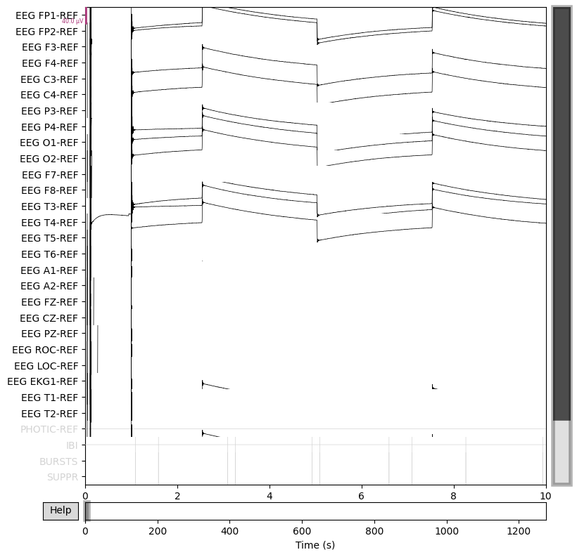
Filtering
Done:
Bandpass: 0,5-100 Hz
Notch: 60 Hz
Crop start + end of recording
Note done (but should be!)
Remove EOG artefacts
Remove ECG artefacts

Slide 12
EDA conclusion
Crucial info is missing: Source information + Meta data
What is separating the groups? => can steer analysis + feature engineering
Where/how/by whom is recorded?
Consequence:
Unnecessary long puzzling
Risk of false comparison/assumptions between groups
No Source + Metadata == No (usable) Data

Slide 13
Feature Engineering

Slide 14

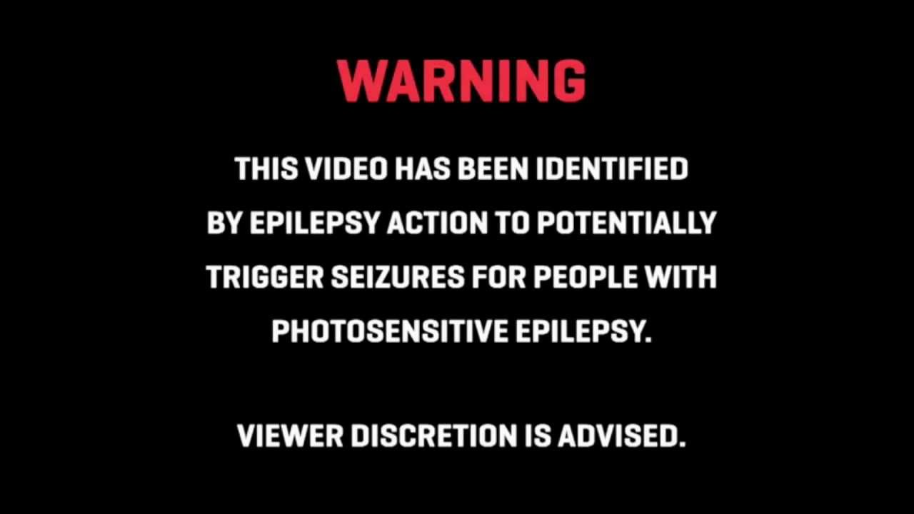
Intermittend Photic Stimulation
Pulse train found in some recordings
Unfortunately not all channels

Slide 15
No consistent stim found
Group | Recording | Channel | Mean
1 | 1 | BURSTS | 0.339228
1 | 2 | BURSTS | 0.0
1 | 3 | BURSTS | 0.0
1 | 4 | BURSTS | 0.392392
2 | 1 | BURSTS | 0.237873
2 | 2 | BURSTS | 0.0
2 | 3 | BURSTS | 0.0
2 | 4 | BURSTS | 0.0
1 | 1 | IBI | 22.108351
1 | 2 | IBI | 0.0
1 | 3 | IBI | 0.0
1 | 4 | IBI | 10.253176
2 | 1 | IBI | 1.674255
2 | 2 | IBI | 0.0
2 | 3 | IBI | 0.0
2 | 4 | IBI | 0.0
1 | 1 | PHOTIC-REF | 0.000003
1 | 2 | PHOTIC-REF | 0.000002
1 | 3 | PHOTIC-REF | 0.0
1 | 4 | PHOTIC-REF | 0.000004
2 | 1 | PHOTIC-REF | 0.000003
2 | 2 | PHOTIC-REF | 0.0
2 | 3 | PHOTIC-REF | 0.0
2 | 4 | PHOTIC-REF | 0.0
Don’t know what is done
If these recordings are comparable

Slide 16
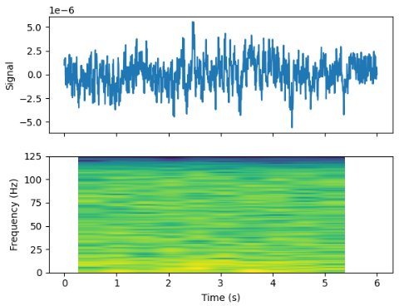
Spectogram (time-freq analysis)
Many windows = many samples!
(not as good as more subjects)

Slide 17
Where to take window?
Ideally:
Events that subjects are in same mental state
Same (lack of) ext. triggers / all in resting
HOWEVER: No epochs/annotation/description
Assumption: all subjects same mental state + physical state + same procedure
This is clearly not the case, but limited time => cutting corners
10s windows + 5 sec overlap
Nyquest: 0.5-100 Hz => >= 4 sec window

Slide 18
Build model + Model Evaluation + Explainability

Slide 19
ML Models
Unsupervised
+ fast, no pre knowledge, unbiased
- less info to train
Supervised
+ use class info to your advantage
PCA
tSNE
Clustering
Further exploration!?
XGBoost
CNN?
Preferred

Slide 20
Unsupervised
I like it: can help give indication of what happens in data
PCA => linear technique

Slide 21
XGBoost
Gradient boosted decision tree
When in doubt => Use XGBoost!
+ Not sensitive to scaling
+ High performance
+ Easy feature importance tools

Slide 22
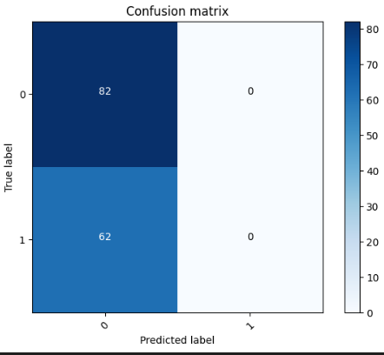
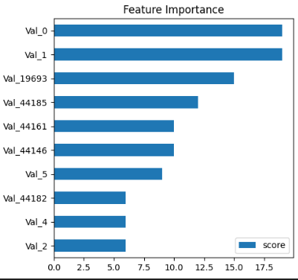
How does it do?
Needs translation to back to freq + bin

Slide 23
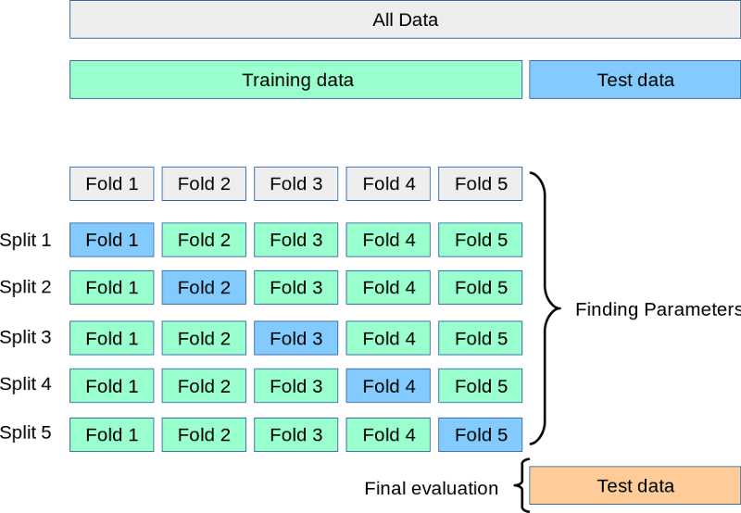

Slide 24
Hyperparameter tuning

Slide 25
Stuff that affects performance
Filtering
Window length
Nr of windows
Spectogram:
Resolution
Freq Range
XGBoost:
Depth
N-times
CrossValidation
NN:
Layers
Nodes
Training
Loss function
Training rate
…

Slide 26
Conclusions

Slide 27
Conclusions
Data info crucial for design
Design is crucial for data choice
NN lend themselves good for images
Training more challenging
Explainability more challenging => heat map could help identify patterns

